Slide 1

FILLING THE VACUUM
“The PLAYBOOK”

Slide 2

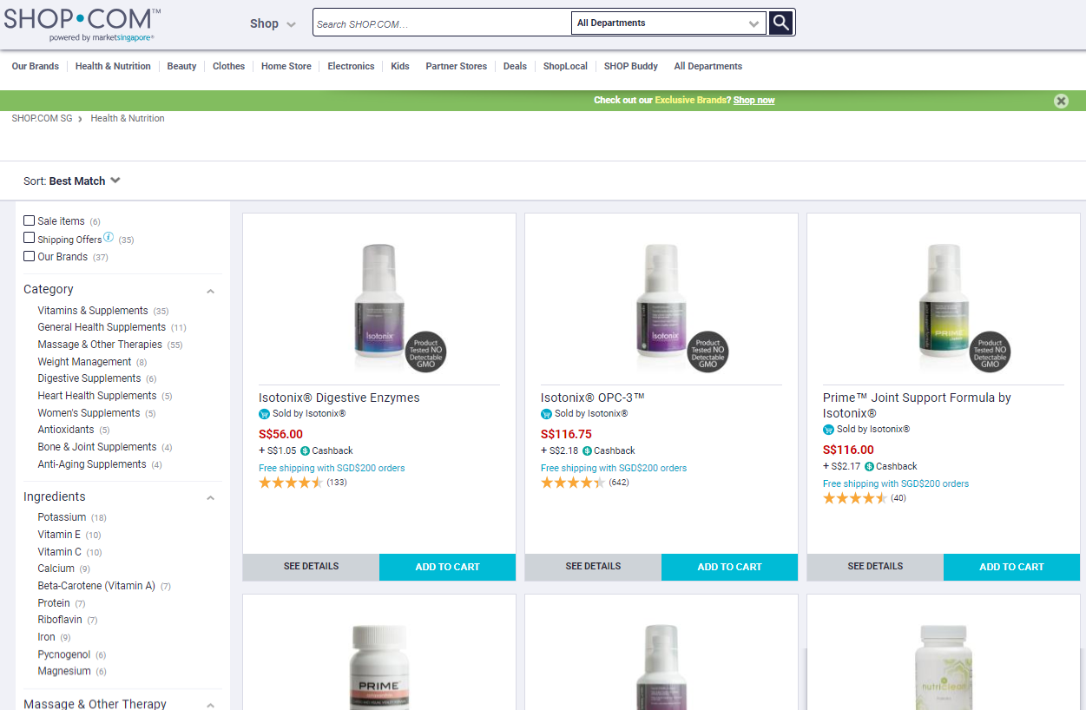
PLAY 1
90 Days to transfer 150-250 BV from “Other Brands” to YOUR BRAND
Use Consistently & Correctly Fast Start Kit products
Complete Home Shopping List
Look Up BV Values for ma Branded products checked off
Revise Autoship Order* before first pull if needed

Slide 3
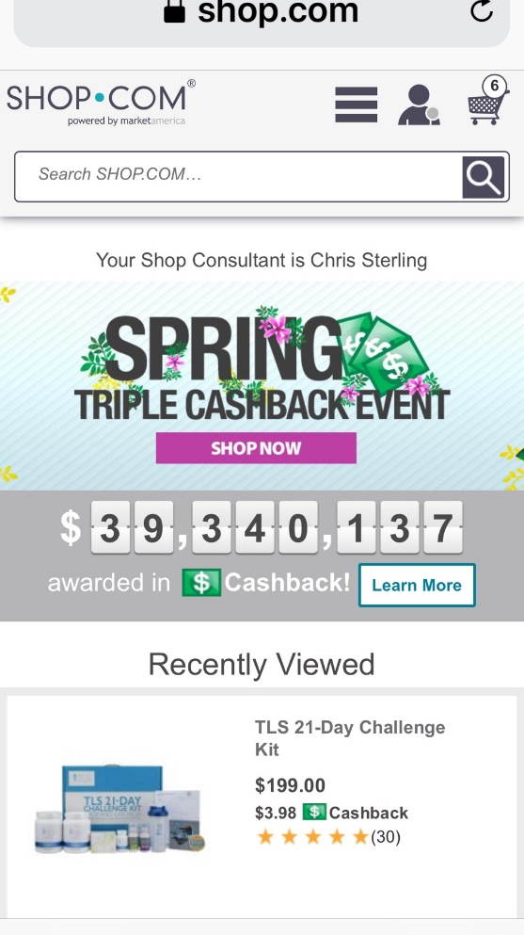
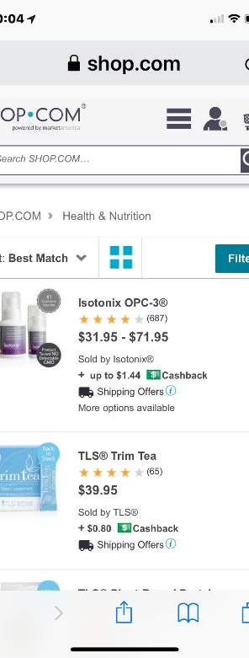
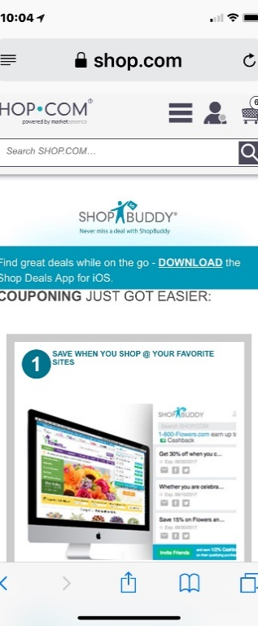
PLAY 2
Change how you buy, and where you buy...
Save your SHOP.COM’s PPCID & Password on “Every Computer”
“Surf” SG.SHOP.COM site
Conduct inventory of “Stores” you currently buy from
Install “Shop Buddy”
“What you are going to buy anyway!”

Slide 4

PLAY 3
Create Possibility List 60-300 Names & Contact Info. in first 10 days
Address Book
Contact from Phone
Facebook
Instagram
Twitter...etc
Who do you know that...

Slide 5

Sell 100 BV in “New Product” / month for the first 12 months
Talk/converse with 16 Possibilities/Names per month
Ask questions/probe for problems or challenges
Listen...for product solutions
Use testimonials/success to create new sales
Complete Home Shopping List with ALL customers
PLAY 4

Slide 6

Show Business Plan to ≥ 4 Qualified Possibilities per month
Talk/converse with 16 Possibilities/Names per month
Ask questions/probe for problems or challenges
Listen...for financial solutions
Use testimonials/success stories to create interest
Use UBP Video...(3 parts)
Complete Home Shopping List after video and register as PC
PLAY 5

Slide 7

Training in first 90 days
NEW UNFRANCHISE OWNER TRAINING (NUOT) ≤ 28 days
BASIC FIVE TRAINING (B5) ≤ 60 days
NUOT
B5
Executive Coordinator Certification Training (ECCT)
Attend Local Seminar...Buy 3 Tickets
PLAY 6

